Slide 1
Introduction to Machine Learning: A Hands-on Workshop
Zoë Wilkinson Saldaña, MSI
Arcus Education, DBHi

Slide 2

Hello!
Background: data science in academic libraries (Cornell University, University of Michigan)
Research interests: critical data science pedagogy; open source collaboration; reproducibility
Zoë Wilkinson Saldaña, MSI
Data Instructional Specialist
Arcus Education

Slide 3
Machine Learning with METACHOP
Introduction to Machine Learning *
Machine Learning II / Topics in ML

Slide 4
Machine Learning with METACHOP
Our schedule for today:
Presentation + Colab Setup: :9:10am – 10am
Hands-on Notebooks: 10am– 11:20am
Wrap-up discussion: 11:20am-11:30am
Self-guided work, learner questions: Here till noon

Slide 5
TAKEAWAYS
Connect research questions with machine learning methods
Write, run, and iterate on a classification pipeline in Python that generates meaningful metrics of “success”
Find peers, colleagues, collaborators, co-learners

Slide 6

Turn to your neighbors
What project or problem are you currently working on that you hope to apply machine learning to?
What is the most important thing you hope to learn today?
Icons made by Freepik from www.flaticon.com

Slide 7
What is machine learning?

Slide 8
What is machine learning?
Generalizing from observed data to new, previously unobserved data (e.g. future observations, new datasets in problem domain)
Focused on prediction tasks such as assigning a label or value
Data-driven models that “learn” when exposed to training data

Slide 9
Relationship to Statistics
Statistics
model first
inference emphasis
Machine learning
data first
prediction emphasis

Slide 10
Types of Machine Learning
Supervised
Unsupervised
Reinforcement

Slide 11
Supervised learning
Given input variables or features, predict the correct output or target
Can predict two types of target:
label (benign /malignant) or
quantity (9 hours)
Relies on labeled training data
(x_{i},yi)∝p(x,y) i.i.d.
x_{i}∈ℝ^{p}
y_{i}∈ℝ
f(x_{i})≈y_{i}

Slide 12
Supervised learning
(MI = myocardial infarction)
Given input variables or features, predict the correct output or target
Can predict two types of target:
label (benign /malignant) or
quantity (9 hours)
Relies on labeled training data
Deo, R. C. (2015). Machine learning in medicine. Circulation, 132(20), 1920-1930.

Slide 13
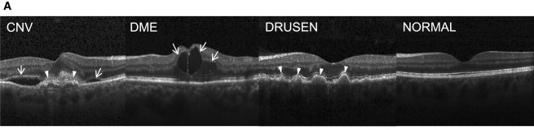
Examples of Supervised Learning
Detecting spam based on e-mail characteristics
Diagnosing retinal disease based on OCT images
Predicting sepsis events based on NICU vitals
Kermany, D. S., Goldbaum, M., Cai, W., Valentim, C. C., Liang, H., Baxter, S. L., ... & Dong, J. (2018). Identifying medical diagnoses and treatable diseases by image-based deep learning. Cell, 172(5), 1122-1131.

Slide 14
Generalization
Not only f(x_{i})≈y_{i}
Also for new data: f(x)≈y
Generalize from:
Training -> test data
Trained model -> new observations in field (e.g. classification at bedside)
Trained model -> new observations in totally different domain
…
Feature selection in ML process -> subsequent study of features

Slide 15
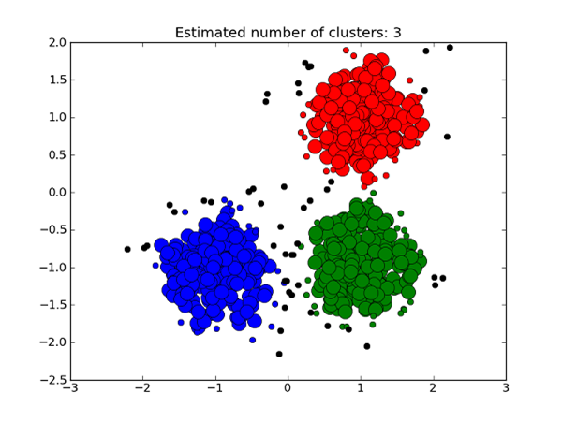
Unsupervised Learning
Given input features, assign to a cluster or class
System must detect groups ”on its own” – training data doesn’t have labels
x_{i}∝p(x) i.i.d.
Learn about p.
https://medium.com/deep-math-machine-learning-ai/different-types-of-machine-learning-and-their-types-34760b9128a2

Slide 16
Unsupervised Learning
Clustering: detect k groups of observations and assign new observations a group
often exploratory
Dimensionality reduction: reduce the number of variables in data while losing as little information as possible
“clustering for variables”
Sidey-Gibbons, J. A., & Sidey-Gibbons, C. J. (2019). Machine learning in medicine: a practical introduction. BMC medical research methodology, 19(1), 64.

Slide 17
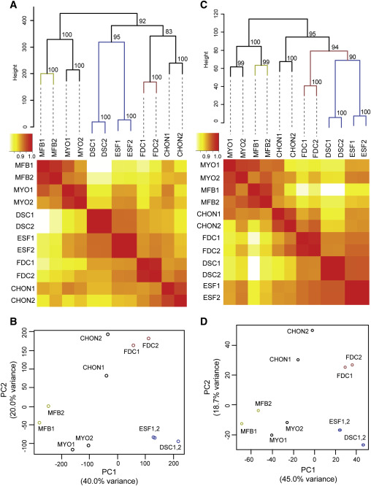
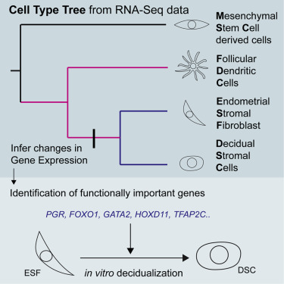
Unsupervised Learning
Task: Infer historical relationships among cell types, and use to learn more about gene expression
Kin, K., Nnamani, M. C., Lynch, V. J., Michaelides, E., & Wagner, G. P. (2015). Cell-type phylogenetics and the origin of endometrial stromal cells. Cell reports, 10(8), 1398-1409.

Slide 18
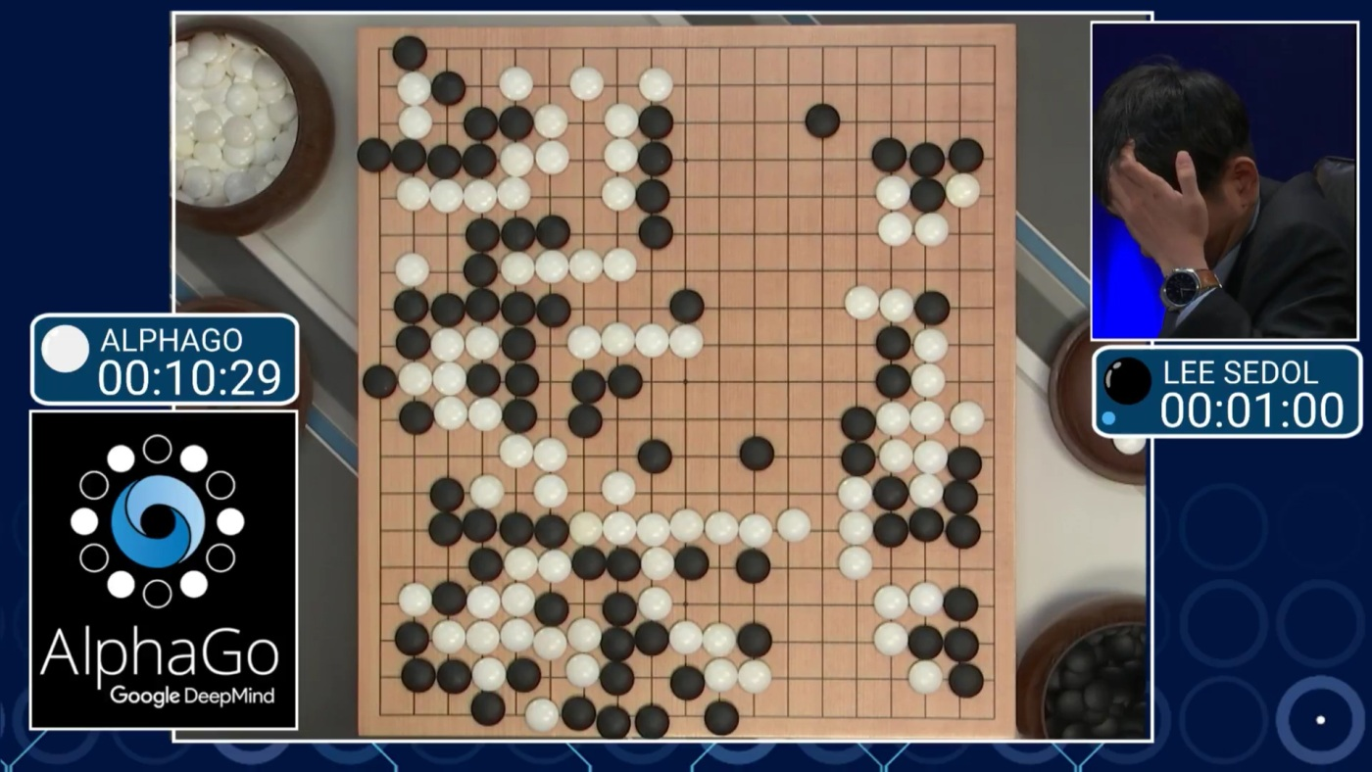
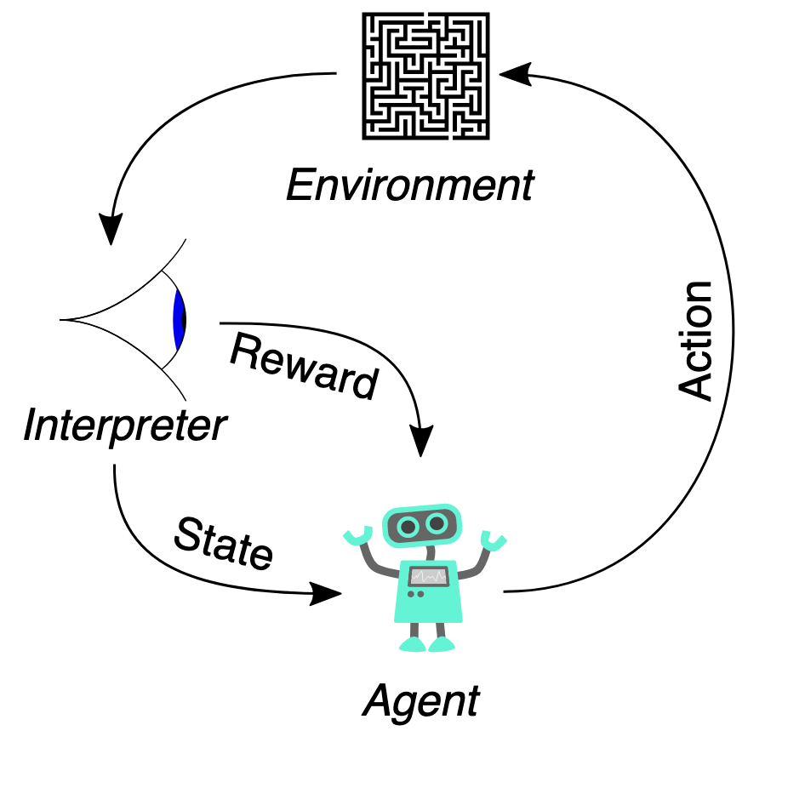
Reinforcement Learning

Slide 19
Features and targets
(MI = myocardial infarction)
Features are all the variables you will use to make a prediction.
Usually a 2D array or matrix
Targets are the outcome variables we are trying to predict.
Usually a 1D array
Deo, R. C. (2015). Machine learning in medicine. Circulation, 132(20), 1920-1930.

Slide 20
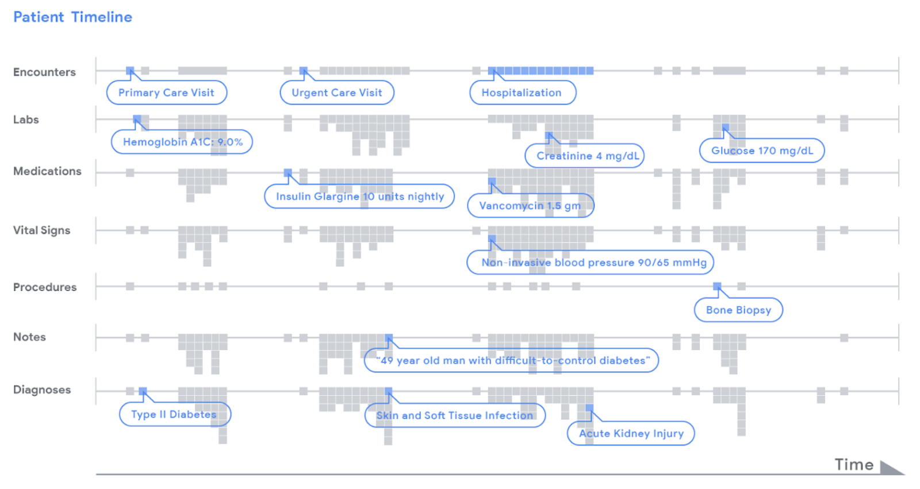
Features and targets
https://ai.googleblog.com/2018/05/deep-learning-for-electronic-health.html

Slide 21
Turn to your neighbors
With your neighbor, come up with an example of a research question for:
Classification (labeled training data, category output)
Regression (labeled training data, numeric output)
Clustering (unlabeled training data, cluster class output)
Icons made by Freepik from www.flaticon.com

Slide 22


Model selection
Deo, R. C. (2015). Machine learning in medicine. Circulation, 132(20), 1920-1930.

Slide 23
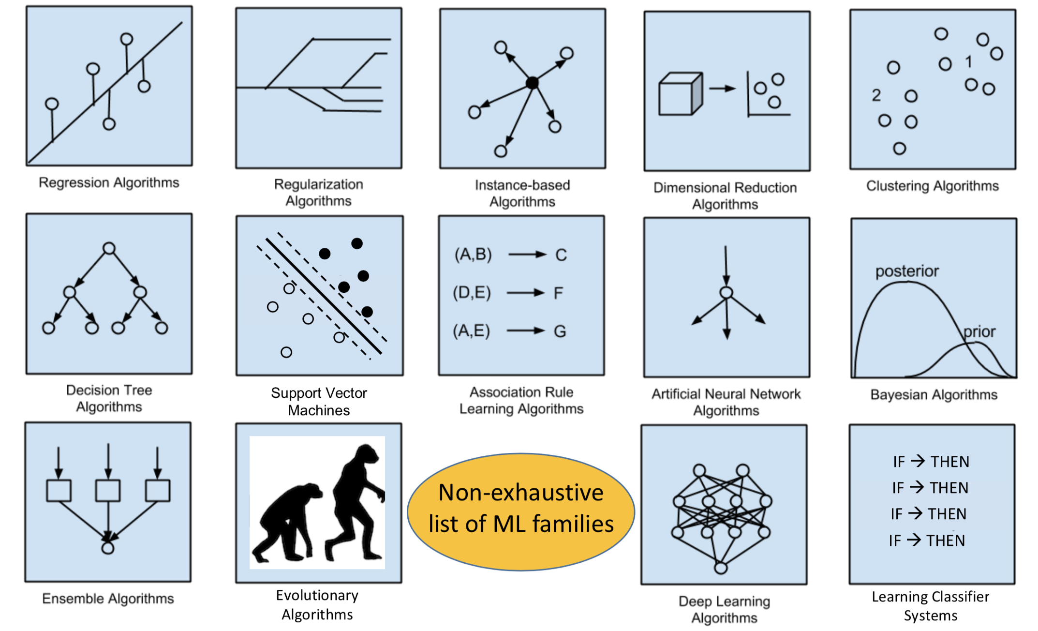
No free lunch theorem
Urbanowicz, Ryan. 2019. https://github.com/UrbsLab/ML_Pipeline_Notebooks/

Slide 24
Start with your task + data
Am I trying to reduce complexity of my data’s features?
2) Is my training data labeled? (do I know the “right answer”?)
3) If so, am I predicting a categorical or continuous/numeric target?

Slide 25
Start with your task + data
Am I trying to reduce complexity of my data’s features?
Dimensionality reduction or not?
2) Is my training data labeled? (do I know the “right answer”?)
Supervised or unsupervised?
3) If so, am I predicting a categorical or continuous/numeric target?
Classification or regression?

Slide 26
Model selection (& “no free lunch” theorem)
https://blogs.sas.com/content/subconsciousmusings/2017/04/12/machine-learning-algorithm-use/

Slide 27
Model selection (& “no free lunch” theorem)
YES training data is labeled

Slide 28
Supervised classification models for today
k-nearest neighbor (instanced-based or lazy learning)
Kernel SVM (support vector machine)
Random Forest (ensemble of decision trees)

Slide 29
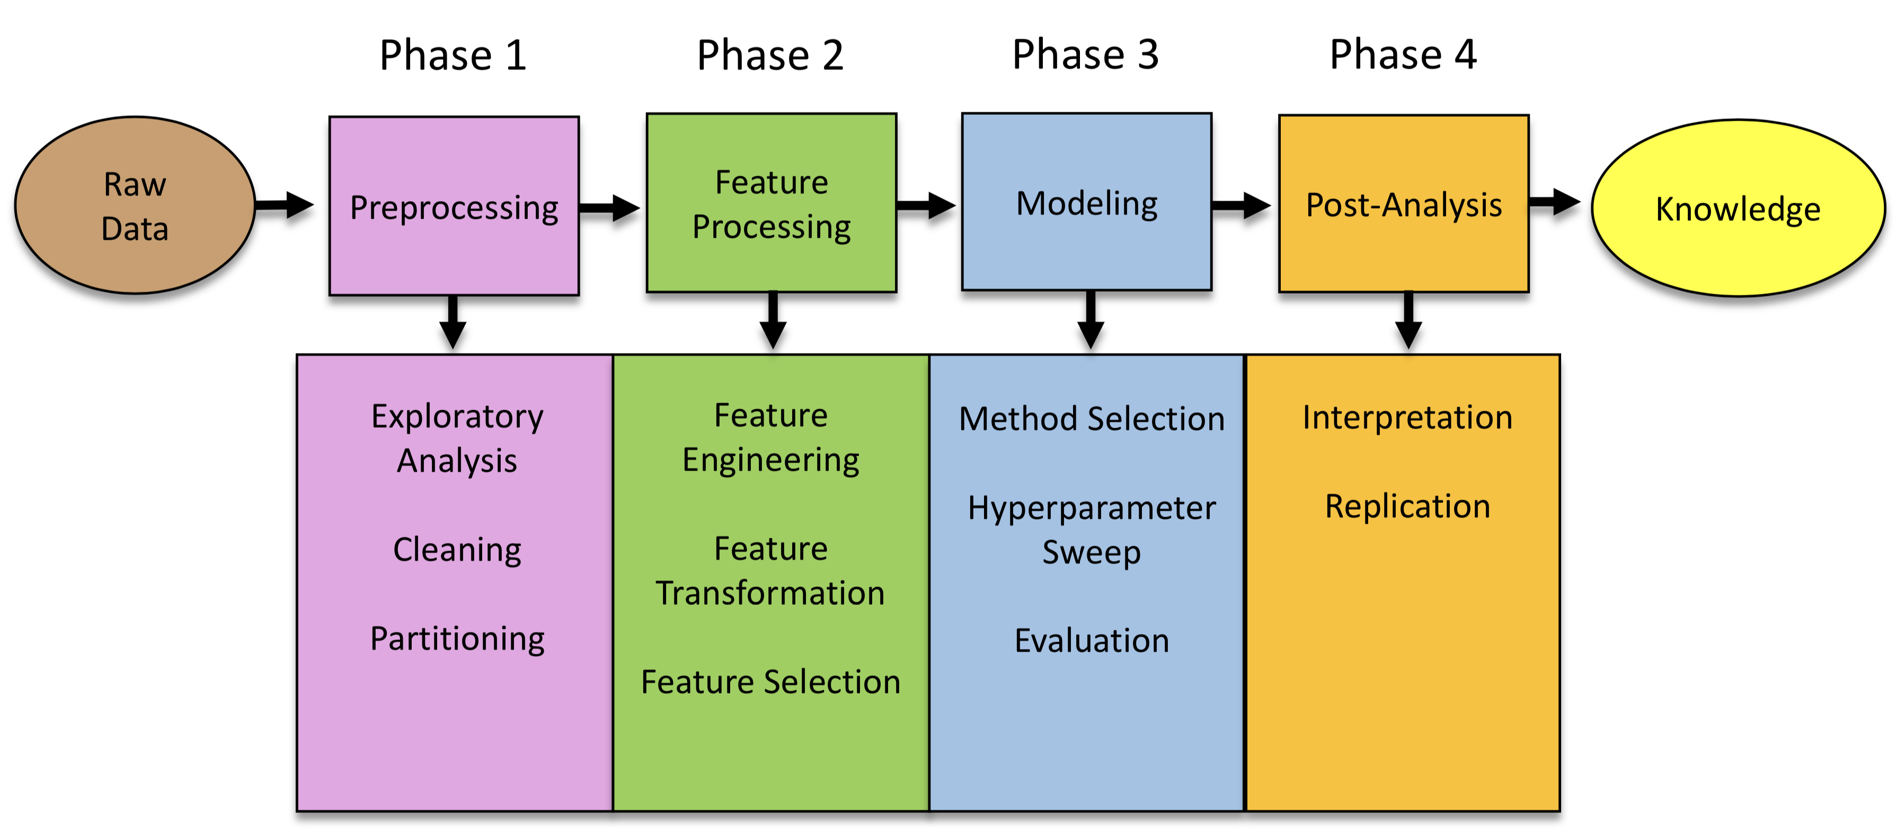
The full spectrum
Urbanowicz, Ryan. 2019. https://github.com/UrbsLab/ML_Pipeline_Notebooks/

Slide 30

For today

Slide 31
Notebook!

Slide 32
Parameters vs hyperparameters
Parameters: Weights, rules, and other learned elements that algorithm uses to assign output class.
Hyperparameters: Settings that determine how the learning algorithm functions. Can be modified or “tuned” for optimal performance.

Slide 33
Metrics of performance
Accuracy: True positive + True negative / All cases
Precision: True positive / True positive + False positives
Recall: True positives / True positives + False negatives
How do these relate to Type I and Type II error?

Slide 34
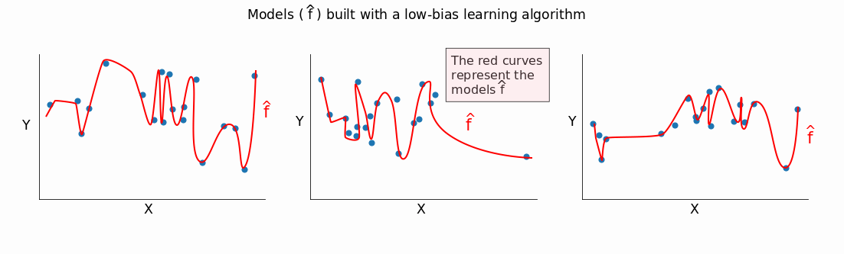
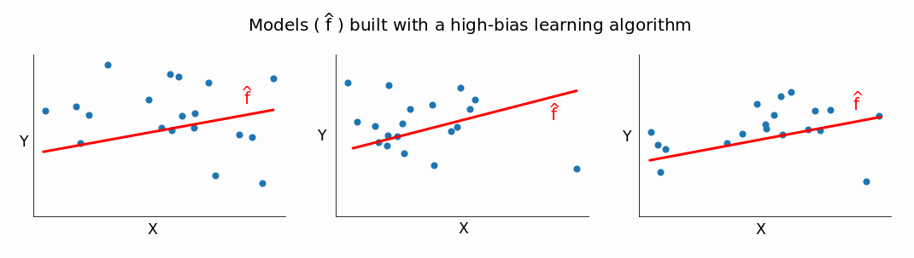
Metrics of performance
Bias
Variance
https://www.dataquest.io/blog/learning-curves-machine-learning/

Slide 35

Metrics of performance
Bias
Variance
https://www.dataquest.io/blog/learning-curves-machine-learning/

Slide 36
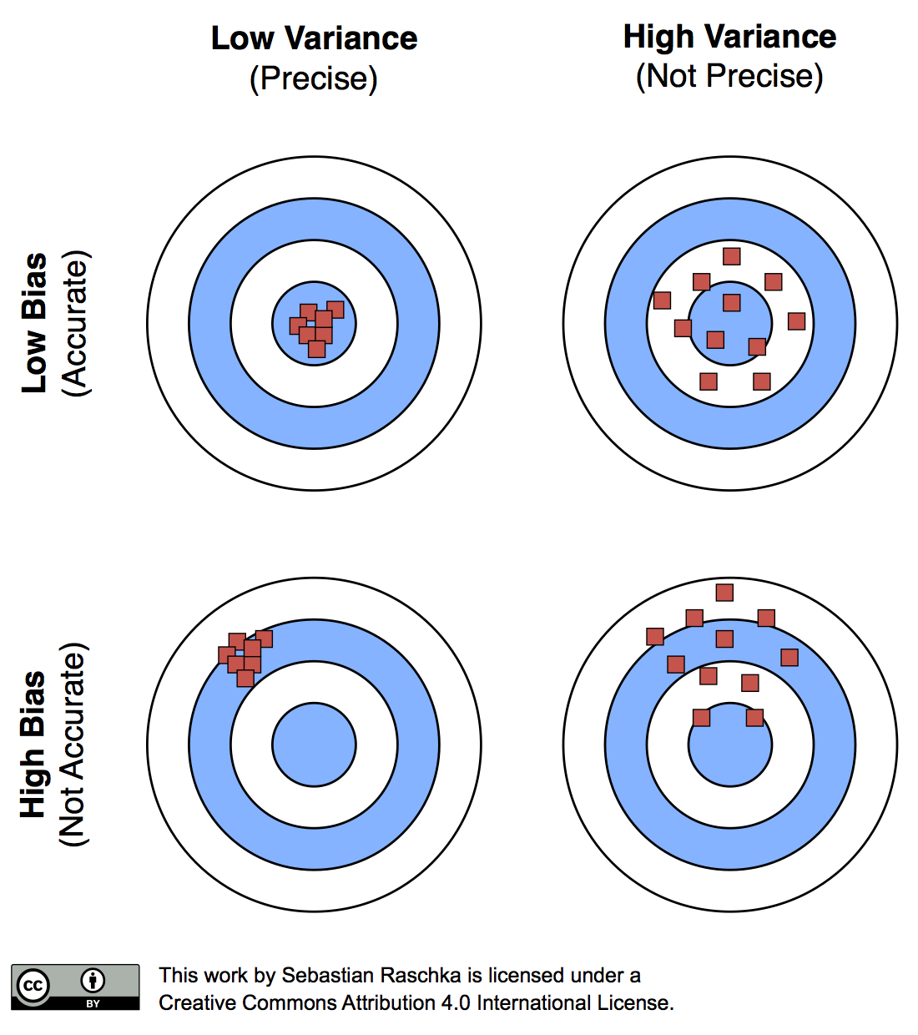
Metrics of performance
Bias
Variance

Slide 37
Turn to your neighbors
What types of tasks are a good fit for machine learning?
What are some of the difficulties of applying machine learning in your domain of expertise?
Where do you think bias (in the broader sense) may impact machine learning?
Icons made by Freepik from www.flaticon.com

Slide 38
Identifying Medical Diagnoses and Treatable Diseases by Image-Based Deep Learning
https://www.sciencedirect.com/science/article/pii/S0092867418301545?via%3Dihub
https://www.youtube.com/watch?v=EuBBz3bI-aA

